Slide 1
Developing TypeScript and AngularJS
Notes:
The module examines developing client-side web apps using TypeScript and the single page application (SPA) model. The module begins with a primer on developing with the TypeScript language and a discussion of the role that TypeScript definition files play when programming against JavaScript libraries such as jQuery. Next, the module introduces students to the AngularJS framework version 1.5 and teaches students how to get started developing web apps using Angular routes, views and controllers. Students will also learn how to create custom Angular services to encapsulate custom business logic and to increase code reusability and maintainability.

Slide 2
Agenda
Moving from JavaScript to TypeScript
Introduction to AngularJS
Angular Routes, Views and Controllers
View Models and Form Validation
Programming with Asynchronous Services
Creating Angular Components

Slide 3
What is TypeScript?
A programming language which compiles into plain JavaScript
A superset of JavaScript that adds a strongly-typed dimension
It can be compiled into ECMAScript3, ECMAScript3 or ECMAScript 6
It runs in any browser, in any host and on any OS
product.ts
product.js
TypeScript
Compiler
Notes:
There is a getting started tutorial at https://www.typescriptlang.org/docs/tutorial.html .

Slide 4
Type Annotation
TypeScript allows you to annotate types
Provides basis for strongly-typed programming
Type annotations used by compiler for type checking
Type annotations are erased at the end of compile time

Slide 5
Assignment with let versus var
var does not recognize nor honor scope
let will recognize and honor scope

Slide 6
Parameter Arrays

Slide 7
Arrow Function Syntax
TypeScript supports arrow function syntax
Concise syntax to define anonymous functions
Can be used to retain this pointer in classes

Slide 8
Classes
TypeScript supports defining classes
Class defines type for object
Export keyword makes class created across files
Class can be passed as factory function
Default accessibility is public

Slide 9
Class Constructors
Constructor parameters become fields in class
Client-side code calls constructor using new operator

Slide 10
Interfaces
Interface defines a programming contract
Classes can implement interfaces
Client code can be decoupled from concrete classes

Slide 11
TypeScript Definition Files (d.ts)
What are TypeScript definition files
Typed definitions for 3rd party JavaScript libraries
DefinitelyTyped provides great community resource
Typed definition files have a d.ts extension

Slide 12
Agenda
Moving from JavaScript to TypeScript
Introduction to AngularJS
Angular Routes, Views and Controllers
View Models and Form Validation
Programming with Asynchronous Services
Creating Angular Components

Slide 13

Introducing AngularJS
What is AngularJS?
A JavaScript framework for building web applications
Based on Single-Page Application (SPA) model
Implements Model-View-Controller (MVC) Pattern
What version should you use?
AngularJS 1.0
AngularJS 1.5
AngularJS 2.0

Slide 14
Angular JS Features
Directive
A shared unit of declarative functionality
Module
A container for a reusable unit of code
Controller
A JavaScript functions which processes incoming requests
View
An HTML template that serves as a partial view on a page
View Model
JavaScript object containing domain-specific data prepared by controller
Object properties declaratively bound to HTML elements in the view
Service
Built-in Angular services include $http, $window and $route
Custom services used to write code which is shared across controllers

Slide 15
Key Angular Directives
ng-app: initialize the Angular app
ng-controller: designate controller scope
ng-view: define placeholder for dynamic views
ng-bind: one-way binding of HTML element to model
ng-model: two-way binding of HTML element to model
ng-repeat: create for-each loop
ng-click: handle click event.
ng-hide: shows or hides an HTML element
ng-href: creates Angular-compliant anchor tags
ng-src: creates Angular-compliant img tags

Slide 16
Service Components included with AngularJS
Angular includes many built-in service components
This tables lists some of the more commonly used services
Service | Purpose
$http | used to communicate with the remote HTTP servers using XMLHttpRequest object
$location | used to retrieve the URL in the browser address bar
$log | safely writes the message into the browser's console
$q | promise/deferred implementation
$window | reference to the browser's window object
$anchorScroll | scrolls to the related element
$filter | used for formatting data displayed to the user
$route | used for deep-linking URLs to controllers and views
$routeParams | allows you to retrieve the current set of route parameters

Slide 17
Understanding Modules
Module represents a container of code
AngularJS provides several built-in Modules
Third parties libraries often created using Modules
Named module can be created for app
App module named using ng-app Directive
App module initialized using angular.module function

Slide 18
App Project Structure
All application code maintained in App folder
App start page implemented using start.html
App initialization code maintained in app.js
Child folders added for controllers, services and views

Slide 19
Agenda
Moving from JavaScript to TypeScript
Introduction to AngularJS
Angular Routes, Views and Controllers
View Models and Form Validation
Programming with Asynchronous Services
Creating Angular Components

Slide 20
Routes, View Template and Controllers
What are Routes?
Route represents endpoint in the app's route map
Route configured with View template and Controller
What is a View Template?
HTML fragment in .html file which acts as partial view
HTML in view template often created using Directives
What is a controller?
JavaScript function which provides view logic
Controller creates and passes model to View Template

Slide 21
Defining Routes
Steps to defining route map for an app
Define routes using the injected $routeProvider object
You must supply templateUrl, controller and controllerAs
Setting HTML5Mode eliminates need for # in routing URLs

Slide 22
Web.config File for an Angular Web App
HTML5 Mode requires server-side URL rewriting support
Can be configured using Web.config file

Slide 23
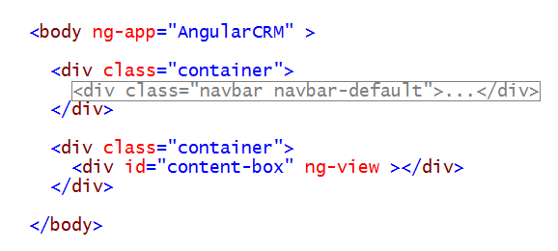
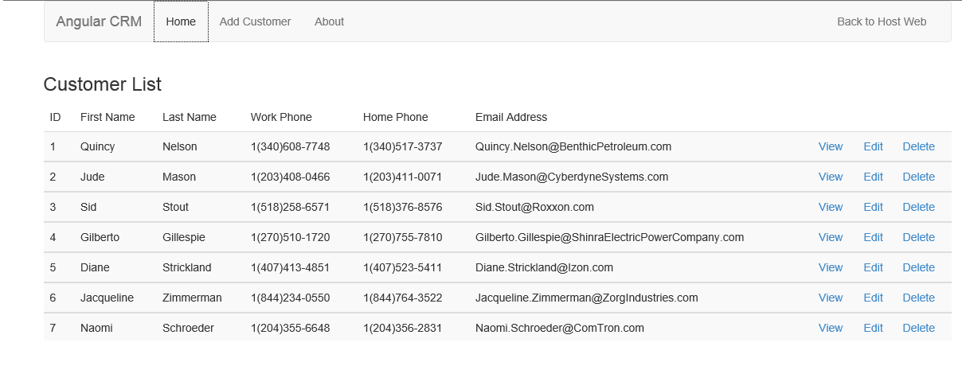
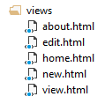
Dynamically Loading View Templates
View placeholder element defined using ng-view attribute
View templates are loaded into view placeholder element

Slide 24
Understanding Controllers
Controllers are implemented using JavaScript functions
Controller registered using controller function on app module
Controller initializes object to serve as view model
View model accessible to view template with ControllerAs variable

Slide 25
Understanding View Templates
View Templates are implemented using HTML

Slide 26
Defining the IProductDataService Interface
Interface can help with design
It decouples controller code from data access code

Slide 27
Custom Services in Angular
What type of code should be written in a service?
Any code shared across controllers or which calls across network
Create service by calling service method on App Module object
How do you use the service from a controller?

Slide 28
Best Practices with Services and Controllers
Controllers should never reference the DOM
DOM manipulation done using custom Directives
Controllers should define view behavior
What happens when user clicks Delete button?
What happens when user clicks Save button?
Controllers should not contain any data access code
Code to call across network should be written in service(s)

Slide 29
Controller Processing Flow
Incoming request routed to Controller using app's route map
Controller calls data access function provided by custom service
Custom service calls across network to fetch SharePoint list data
Custom service returns SharePoint list data to Controller
Controller uses SharePoint list data to create model
Controller passes model to View Template using $scope
View Template binds to model data using Directives
View Templates renders HTML which is returned to client
Incoming Request
Controller
Custom Service
SharePoint REST API
SharePoint
List Data
View Model
HTML
Response
View Template

Slide 30
Key Filters
Format
currency
date
number
Displaying data sets
orderBy
limitTo
String manipulation
uppercase
lowercase

Slide 31
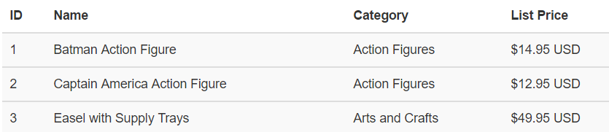
Customer Filters
Custom filter created using filter function

Slide 32
Agenda
Moving from JavaScript to TypeScript
Introduction to AngularJS
Angular Routes, Views and Controllers
View Models and Form Validation
Programming with Asynchronous Services
Creating Angular Components

Slide 33
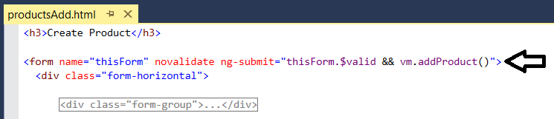
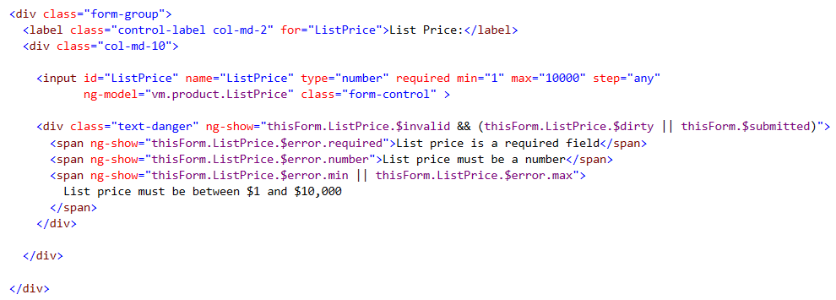
Angular Form Validation

Slide 34
Agenda
Moving from JavaScript to TypeScript
Introduction to AngularJS
Angular Routes, Views and Controllers
View Models and Form Validation
Programming with Asynchronous Services
Creating Angular Components

Slide 35
Asynchronous Interfaces

Slide 36
Calling Asynchronous Methods
Calling asynchronous method requires callback
Callback method pass using then method

Slide 37
Agenda
Moving from JavaScript to TypeScript
Introduction to AngularJS
Angular Routes, Views and Controllers
View Models and Form Validation
Programming with Asynchronous Services
Creating Angular Components

Slide 38
Angular Components
Angular 1.5 introduces components
Designed to replace custom Angular directives
Applications can be designed in terms of components
Represents component-oriented shift into Angular 2.0

Slide 39
Angular Component Classes
Angular component requires two classes
Component controller class
Component options class

Slide 40
Angular Component View Template
Component options provides path to view template
View templates uses $ctrl variable to access view model

Slide 41
Instantiating a Component

Slide 42
Summary
Moving from JavaScript to TypeScript
Introduction to AngularJS
Angular Routes, Views and Controllers
View Models and Form Validation
Programming with Asynchronous Services
Creating Angular Components

